Slide 1

AstroSage Call Center Performance Analysis
Optimizing Operations with Data-Driven Insights
Detailed analysis of key call center metrics including call volume, resolution rates, and customer satisfaction for December 2023 - January 2024.

Slide 2
01
Introduction and Data Overview

Slide 3
Introduction
Problem Statement:
Astro-sage is a website and app mostly used by Hindus that provides astrology services, including horoscope matching, birth chart generation, and AI astrologers.
Astrosage’s call center recently received a ₹1 crore investment. The Goal is to maximize operational efficiency, customer satisfaction, and profitability.
Challenges identified:
Uneven workload among agents.
Rising repeat calls.
Varying customer satisfaction across platforms.
Need to identify where to allocate investment effectively.

Slide 4
Data Overview
Source: AstroSage Call Center system logs
Size: 28,028 consultation records
Attributes:The dataset contains 30 attributes. These attributes include identifiers (ids), categorical fields (agent, guru, product), numeric fields (call duration, sale amount, csat), and time-based fields (date, time).
Time Period Covered: December 2023 – January 2024
Scope of Analysis:
  User behavior (repeat vs new callers)
  Guru performance & workload distribution
  Call outcomes (completed, failed, busy, no-answer)
  Revenue generation by service type (Calls, Chats, Live Sessions)
  Customer satisfaction (CSAT ratings)

Slide 5
02
Analysis and Insights

Slide 6
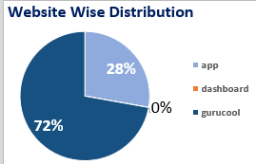
User Base Distribution
Majority of users come from Gurucool (72%), followed by the App (28%), while the dashboard is barely used – showing a clear preference for mobile and platform-first access.

Slide 7
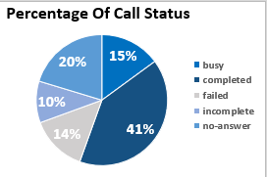
Call Outcome Summary
41% calls are completed, but 14% failed and 20% remained unanswered. This suggests call handling efficiency can be improved. And should focus on Call Completion with a positive resolution and User Satisfaction.

Slide 8
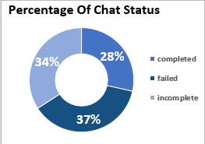
Chat Outcome Summary
28% of Chats are Completed, 37% failed, and 34% are incomplete. Chat efficiency still has room for improvement, especially in the domain of chat completion.

Slide 9
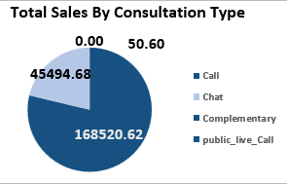
Revenue by Consultation Type
Calls generate the highest revenue (₹1.68 lakh), followed by Chats (₹45k). Public live calls barely adds contribution. Complementary sessions bring no direct revenue.

Slide 10
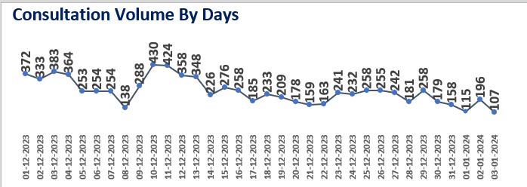
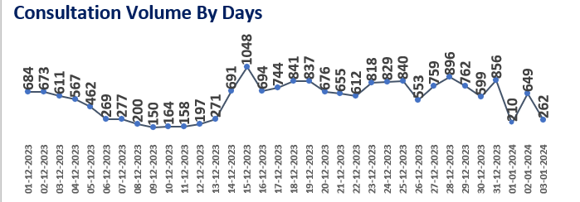
Day wise Consultation Volume
Call volumes fluctuate between 150–450 daily. Noticeable dips are seen around mid-December, Should work on the entire Call infrastructure to maximize the daily calls after the huge 1 Cr Investment.
Consultation Type :- Calls
Chat volumes fluctuate between 450–1,050 daily. Peak volume were seen in late December, followed by mild dips in early January. Users prefer chat over calls consultation, so maintaining the efficiency of current infrastructure is more than sufficient.
Consultation Type :- Chat

Slide 11
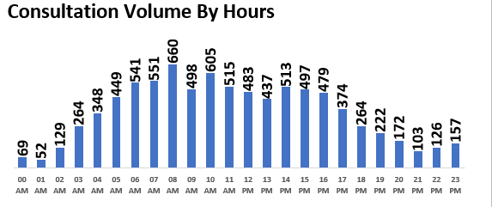
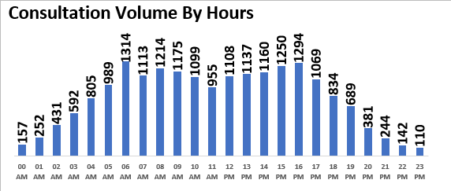
Hourly Consultation Volume
Consultation Type :- Calls
Peak Call activity is between 7 AM – 4 PM, with the Highest volume around 7-11AM. This is the critical area for resource allocation.
Peak Chat activity is between 5 AM – 17 PM, with the Highest volume around 6-10AM and 13-16 PM. This is the critical area for resource allocation.
Consultation Type :- Chat

Slide 12
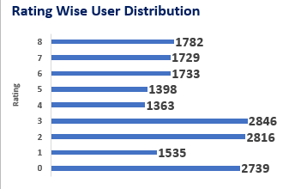
Overall User Ratings
2000 – 2800 Users rate between 0–3, Very few ratings at extremes (6-8). This indicates moderate customer satisfaction, which can be improved by investing in customer issue resolution which can eventually increase the rating.

Slide 13
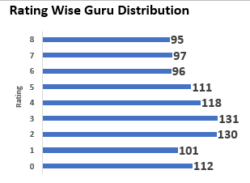
Overview of Guru Ratings
Most gurus are rated around 2–4 , Very few achieve top ratings. This aligns with user distribution, showing consistency in perception and directs the need for grooming sessions for under performing Gurus.

Slide 14
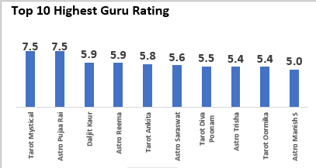
Top 10 Performing Gurus
Astro Pujaa Rai and Tarot Mystical lead the chart with the Highest User Rating (7.5) These top 2 together contribute significantly to engagement, and the other 8 did fairly well.

Slide 15
Key Performance Indicators
The KPIs highlight the key operational and performance metrics of the Astro-Sage call center. A total of 8,508 calls were handled, supported by 19,514 chats, indicating a strong user preference for chat-based interactions. The average daily call volume of 250 reflects consistent customer engagement, while a cost per call of ₹9.14 showcases efficient operational management. However, 57% repeat callers signal recurring customer issues, emphasizing the need to enhance first-call resolution and service quality. The average rating of 2.9 suggests moderate satisfaction levels, calling for improved agent training and better customer experience initiatives. Additionally, the peak hour at 8 AM provides insight regarding the high-demand periods of consultation types(Call, Chat, etc) , helping optimize workforce allocation and resource planning for better service delivery.

Slide 16
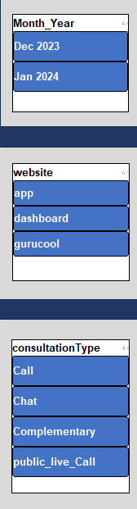
Dashboard Slicers
The slicers add an interactive layer to the dashboard, allowing for dynamic data filtering and focused analysis. The Month_Year slicers (Dec 2023, Jan 2024) enable tracking of performance trends across time,. The Website slicer (App, Dashboard, Gurucool) helps compare platform-wise performance in terms of calls, ratings, and satisfaction. The Consultation Type slicer (Call, Chat, Complementary, Public Live Call) allows users to isolate specific service modes for detailed analysis. Together, these slicers enhance data-driven decision-making.

Slide 17
03
Dashboard Visualization

Slide 18
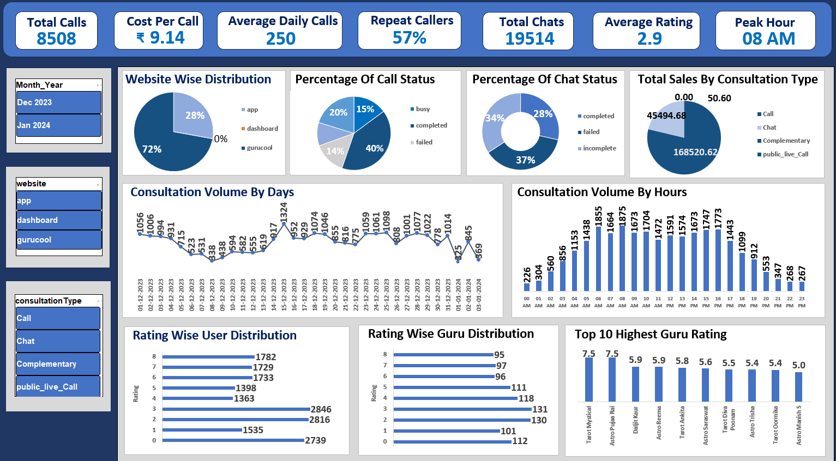

Slide 19
04
Strategic Recommendation

Slide 20
Enhance Agent Performance through Training:
Average ratings (2.9) suggest the need for improved communication and problem-solving skills. Targeted training can help boost first-call resolution and reduce repeat calls (currently 56%).
Optimize Workforce Scheduling:
Use the “Peak Call Periods” analysis to align agent availability with demand - increasing coverage during 6 AM–12 PM when call volume is highest and reducing idle time during low-traffic hours.
Focus on Platform Optimization:
Ratings indicate the Dashboard platform (4.5) performs best; insights from it should guide UX and support improvements in App (3.5) and Gurucool (2.7) platforms to maintain consistent satisfaction across channels.
Leverage Technology and Automation:
Introduce chatbots and smart IVR systems to handle repetitive or simple queries -this can reduce workload, improve response times, and lower cost per call (₹9.14).
Customer Retention Initiatives:
Since repeat callers form a large portion of total calls, implement loyalty or personalized support programs to address recurring issues and enhance long-term satisfaction.
Continuous Monitoring through Dashboard:
Use the slicers for time, website, and consultation type to continuously monitor trends, measure improvements, and quickly adapt strategies based on performance insights.

Slide 21
05
Summarized Conclusion

Slide 22
"Through the power of data-driven insights and strategic investments, AstroSage can turn existing inefficiencies into future strengths — shaping a call center that is efficient, customer-focused, and prepared for the challenges of tomorrow."
The dashboard analysis reveals key operational patterns and improvement opportunities for the call center. With 8,508 total calls, 19,514 chats, and an average rating of 2.9, it is evident that customer satisfaction can be significantly improved through smarter workforce management and targeted training. The 56% repeat caller rate indicates recurring issues that require better resolution quality and follow-up strategies.
By leveraging insights from KPIs, peak hour trends, and platform-wise ratings, the call center can make data-driven decisions to enhance efficiency, reduce costs, and improve customer experience. Overall, focusing on agent development, technology integration, and customer-focused service enhancements will lead to higher satisfaction, optimized operations, and sustainable growth.

Slide 23

Thank You!

